Slide 1


Statas & Probability
Shah Ayub Quadri
Ayub.quadri89@gmail.com

Slide 2
Agenda
Statistics and Probability fundamentals
Installation of R studio

Slide 3
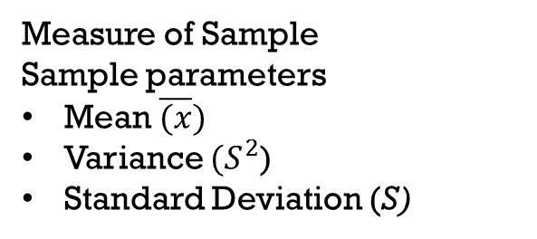
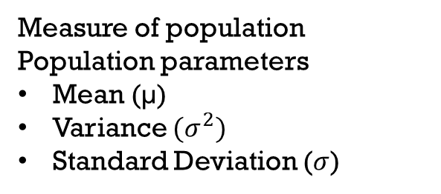
Statistics - fundamentals
Statistics:
It provides a way to extract the information based on the data points or evidence.
Population:
Information about total collection of elements in a data set.
Sample: subset of population
Measure of population
Population parameters
Mean (µ)
Variance ${(σ}^{2})$
Standard Deviation ($σ$)
Measure of Sample
Sample parameters
Mean $\overline{(x})$
Variance ${(S}^{2}$)
Standard Deviation (S)

Slide 4
Descriptive statistics
Data gathered about a set to reach conclusion of the same group
Inferential statistics
Data gathered from a sample & statics generated to reach the conclusion or inference about the population (inductive stats)
Data: Data resents the complete row of a data set or a table
Levels of data Measurement
Nominal -> Categories only
Ordinal -> Categories with some order
Interval -> meaningful diff, but with no zero point
Ratio -> meaningful diff, with a natural starting point
Types Data/variable
Discrete -> Countable data
Continuous -> Measurable data

Slide 5
Identify Discrete or continues
Time between customer arrival at a retail outlet –
Continues
No of defects in a batch of 50 items –
Discrete
Sampling the volume of liquid nitrogen in a storage tank –
Continues
No of flights that are landing with in a duration of 5 mins –
Discrete

Slide 6
Central Tendency
Central position with in the set of data is know as central tendency
Mean, Median & Mode are all valid measure of Central tendency
Mean

